Slide 2
Sermon
on
the Mount
JESUS TAUGHT MUCH ABOUT PRAYER
Matthew 5:44 – pray for those who would use them
Matthew 6:5-15 – attitude and content as well as character of the one praying
Example of Prayer – Mark 1:35
Persistent in Prayer – Luke 6:12
Matthew 26:36-44

Slide 3
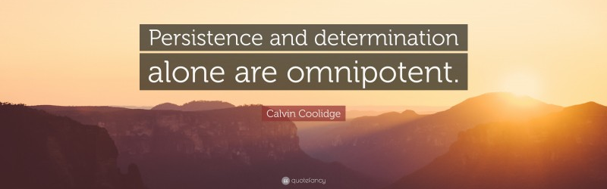
Sermon on the Mount
Matthew 5-7
“Persistent Determination”
Matthew 7:7-11

Slide 4
Sermon
on
the Mount
PERSISTENCE APPLIED TO PRAYER
Three Actions to Show Escalation in Determination
ASK – SEEK - KNOCK
ASK – “crave, demand” - Request
SEEK – “search after/out” - More action on the part of the individual
KNOCK – lit. “knock at the door” - Still More participation involved
Examples: Luke 11:8 “because of his persistence”
Matthew 15:22,23 “great faith”
Luke 18:2-5 “me I will avenge her, lest by her continual coming she weary me.’”

Slide 5
Sermon
on
the Mount
REASONS FOR PERSISTENCE
God Stands Ready to Give and He is Able
Matthew 7:8 Lit. “The one who keeps asking keeps receiving; the one who keeps seeking, keeps finding.”
Diligence Is Rewarded
James 1:5 “let him ask of God, who give to all liberally and without reproach…”

Slide 6
Sermon
on
the Mount
JESUS COMPARES GOD’S WILLINGNESS TO GIVE WITH MAN’S
Matthew 7:9-11
Son not asking for anything unreasonable
Only asking for some food
His father wouldn’t offer a:
Stone > this would be useless
Scorpion > this would be dangerous!
Serpent > this could prove deadly!

Slide 7
Sermon
on
the Mount
JESUS COMPARES GOD’S WILLINGNESS TO GIVE WITH MAN’S
Matthew 7:9-11
IF we have faith in our earthly fathers, do we not have it in our heavenly Father?
Parents’ willingness to give good gifts – even though they themselves are evil
Nothing to do with “depravity” – everything to do with the way some people are
Luke 11:13; Psalm 86:5

Slide 8
Sermon
on
the Mount
PERSISTENCE APPLIED TO THE LIFE OF A CHRISTIAN
Militant Church In The Book Of Acts
Great activity, forcefulness and determination
Great fervency, energy and exertion
Evangelism
Asking people, not waiting to be asked
Seeking people, beating the bushes, not waiting to be found
Knocking for people, great labor
Cannot sit passively and quietly by and win the world for Christ

Slide 9
Sermon
on
the Mount
HOW OFTEN AM I “ASKING, SEEKING & KNOCKING?”
IN COMPARISON TO WAITING?
IF WE DON’T FULLY ENGAGE OURSELVES IN THE LIFE A CHRISTIAN IS SUPPOSED TO LIVE
WE WILL NOT SEE THE DESIRED RESULTS
Are we just “Sitting on the stool of DO NOTHING and WHITTLING ON THE STICK OF DO LESS?”

